Slide 1
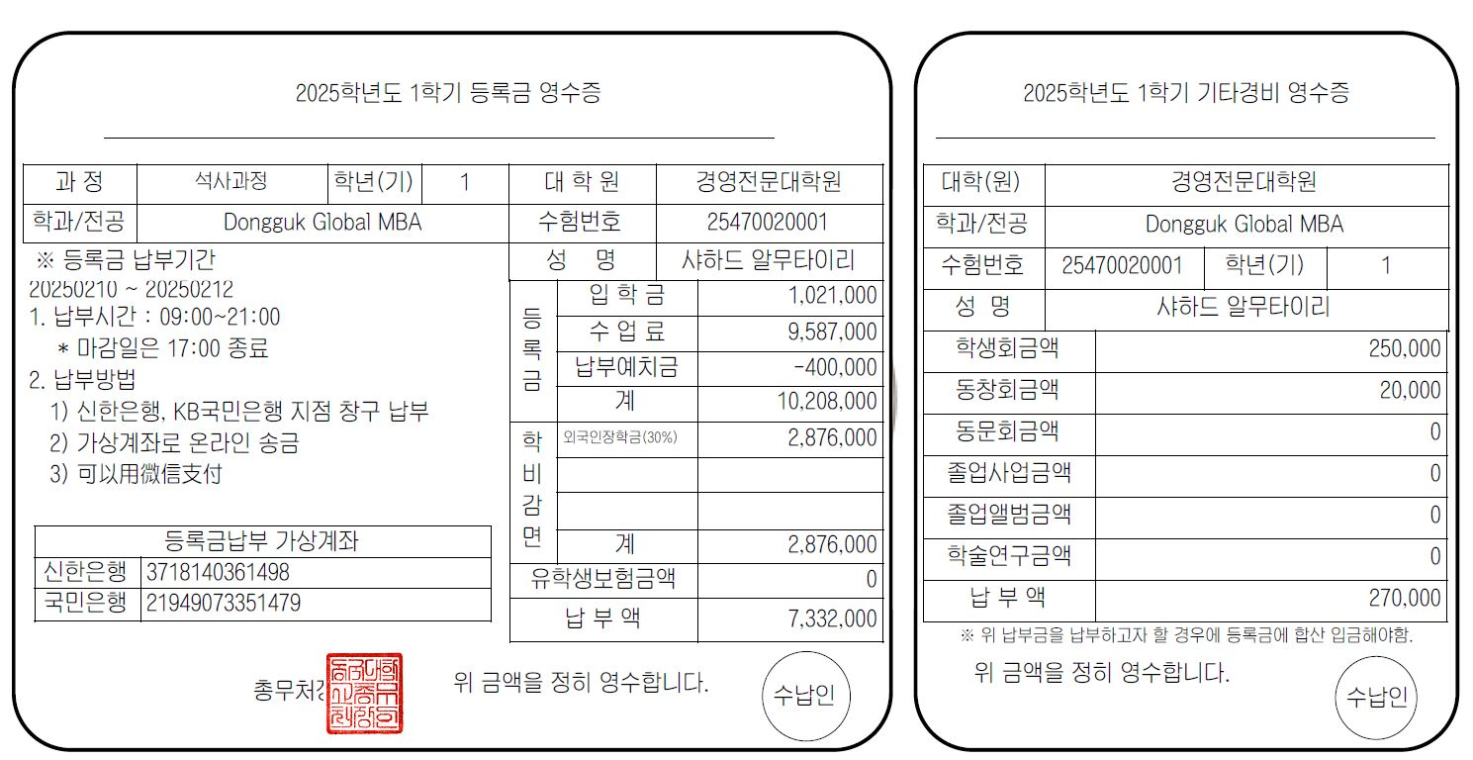
Application No.
Name
Application No.
Name
Tuition& Fees
Tuition Fee
Student Council Fee
Sub-Total
Alumni Association Fee
Tuition Reduction
Scholarship
Virtual Account for Payment
Sub-Total
Shinhan Bank
Kookmin Bank
Total Amount
Total Amount
x,xxx,xxx
Total amount of the Admission Fee and Tuition Fee payable after deducting the deposit paid and scholarship
Optional Fees (You don’t have to pay)
Please pay this in addition to the total amount of your tuition and admission fees if you wish to join the student council and use snacks, etc., provided by the council.

