Slide 1
Lecture Evaluation Procedure
Manual for International Students

Slide 2
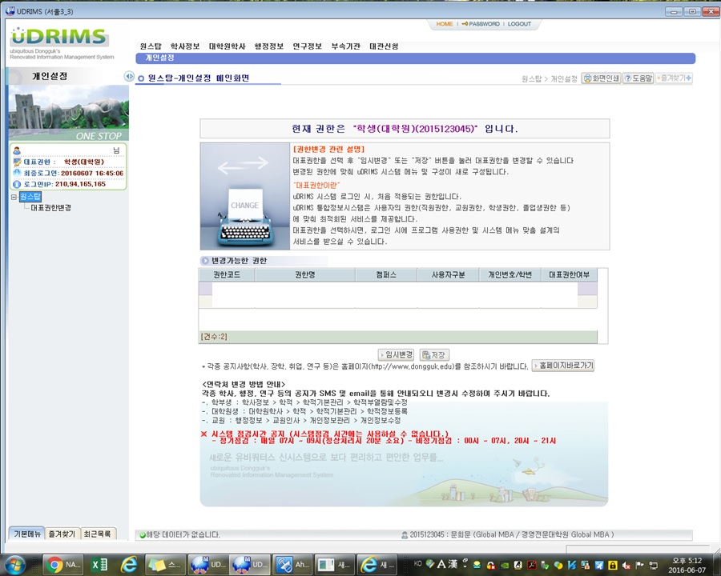
Step 1 : When you login uDRIMS, you can see this page

Slide 3
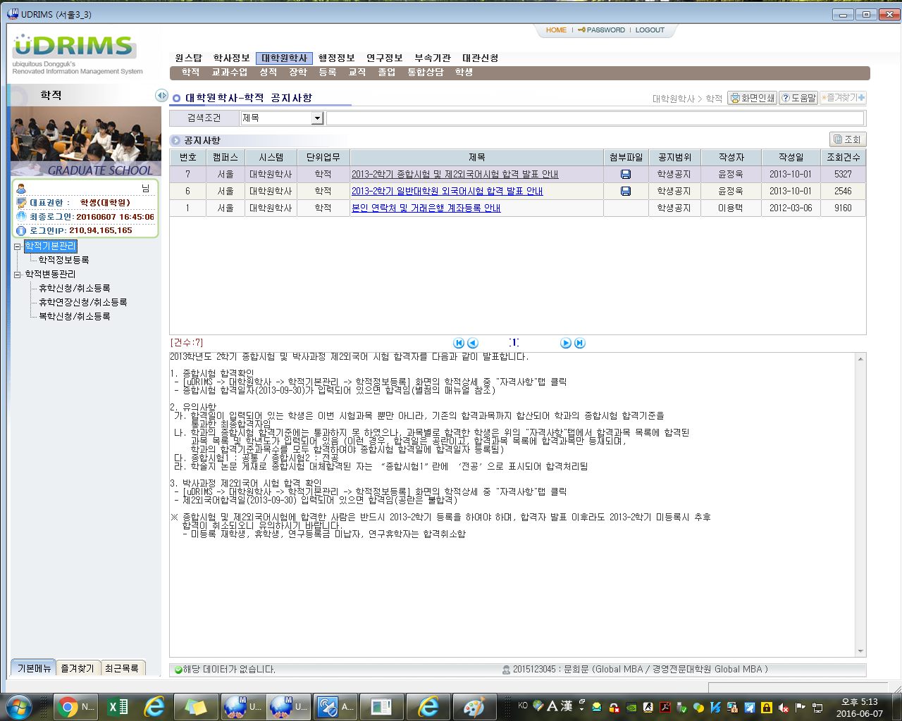
Click
Step 2 : Click 대학원학사

Slide 4
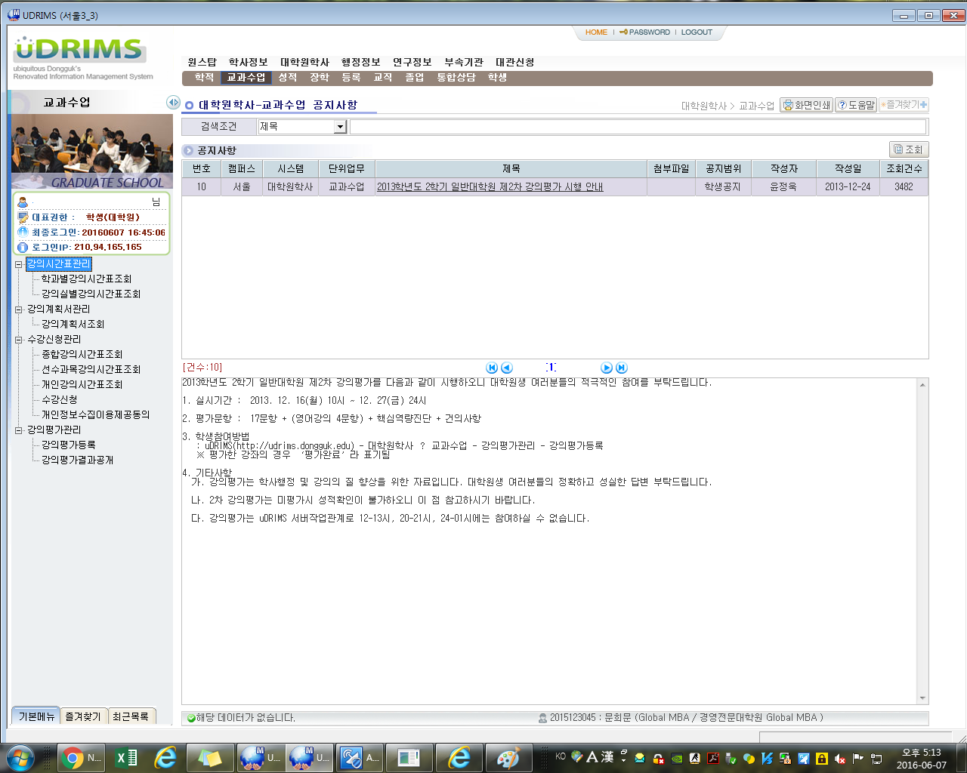
Click
Step 3 : Click 교과수업

Slide 5
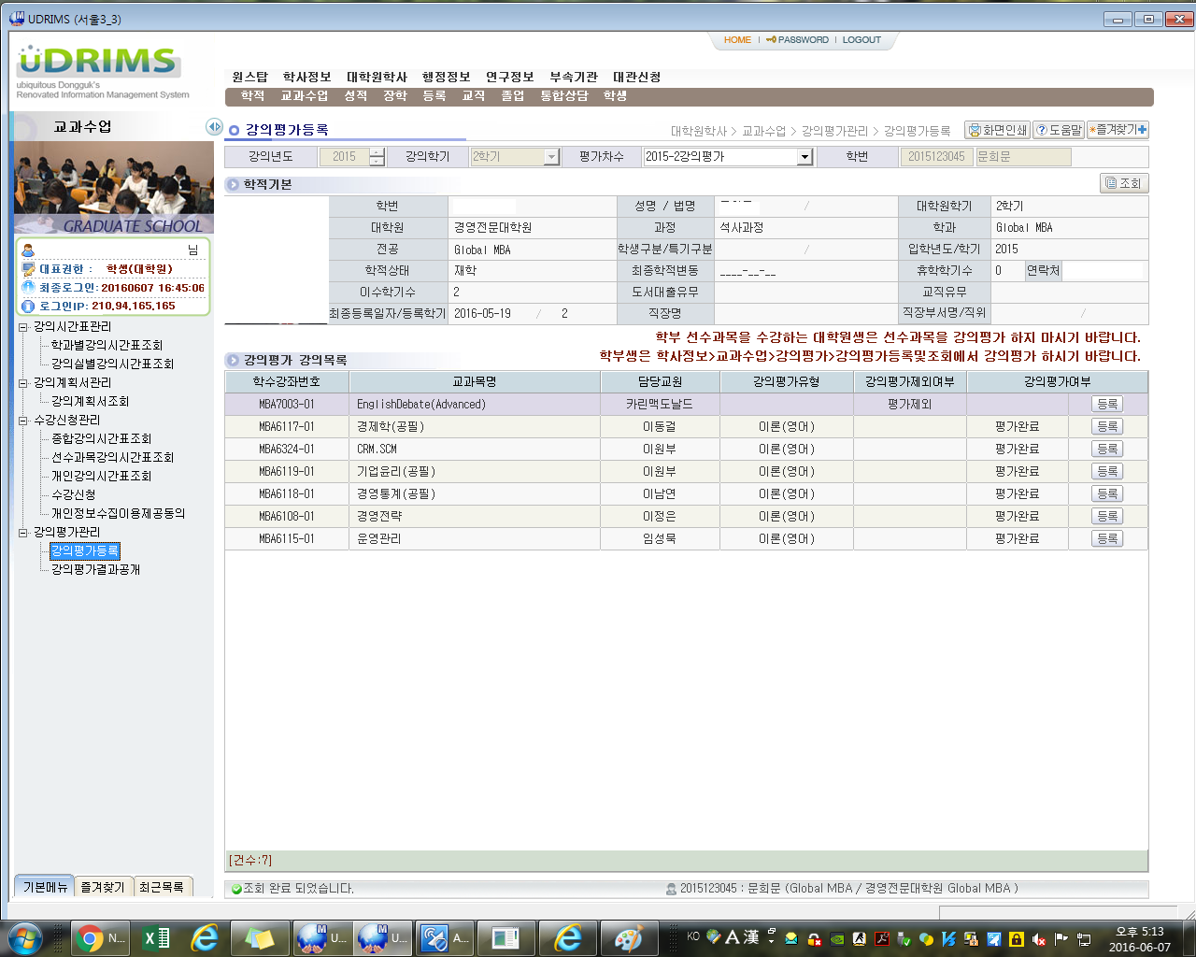
Click
Click
Step 4 : Click 강의평가등록
Step 5 : Click 조회
Step 6 : Your classes will be listed

Slide 6
Click
Step 7 : Click 등록
Step 8 : You can see lecture evaluation page
Step 9 : Finish evaluation → 저장하기 Click

